Slide 1



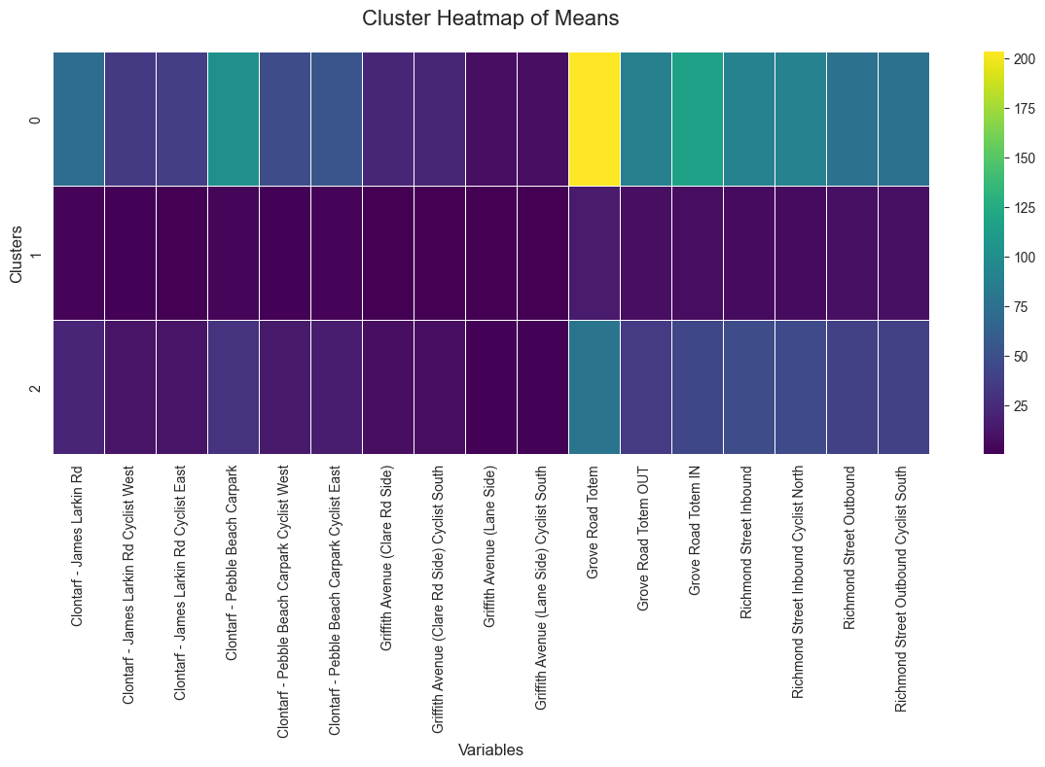
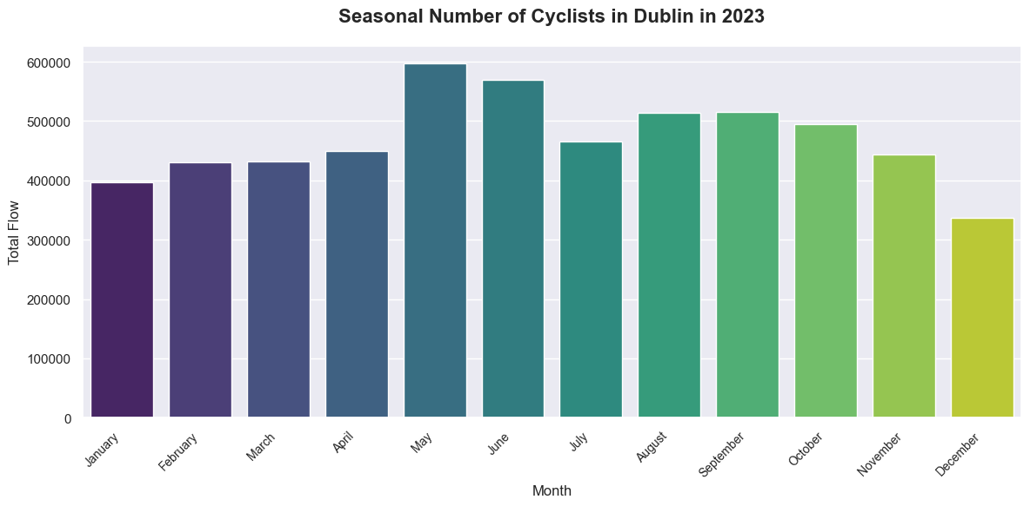
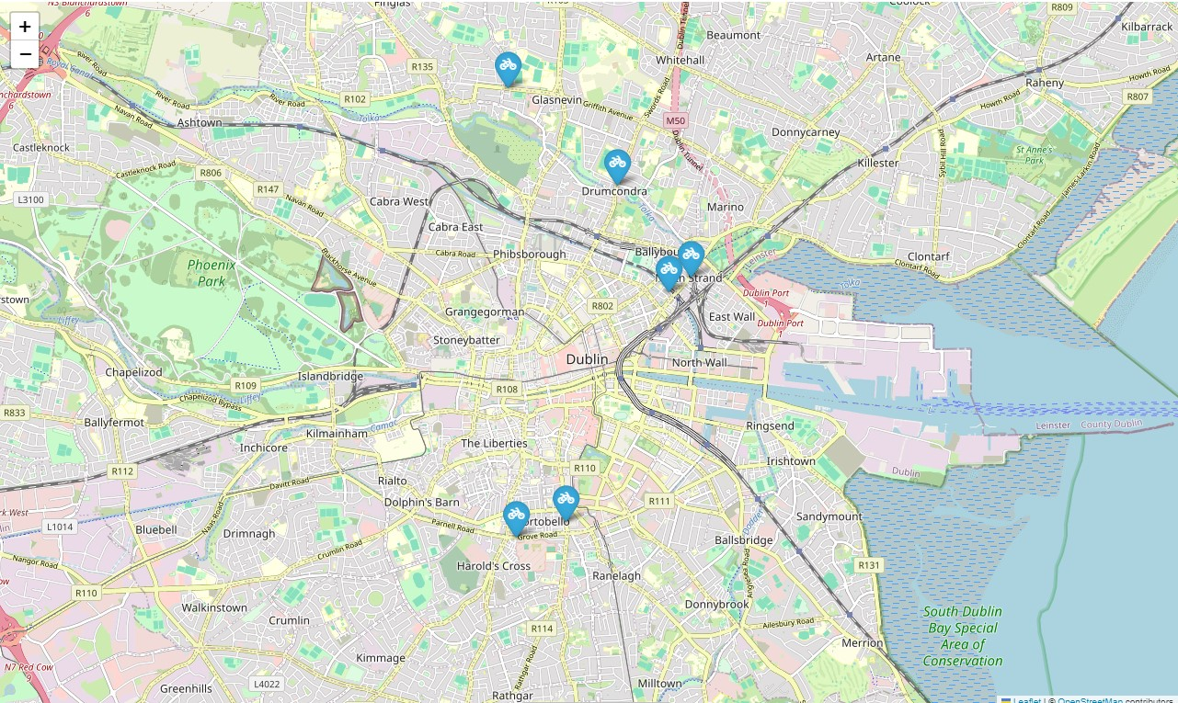
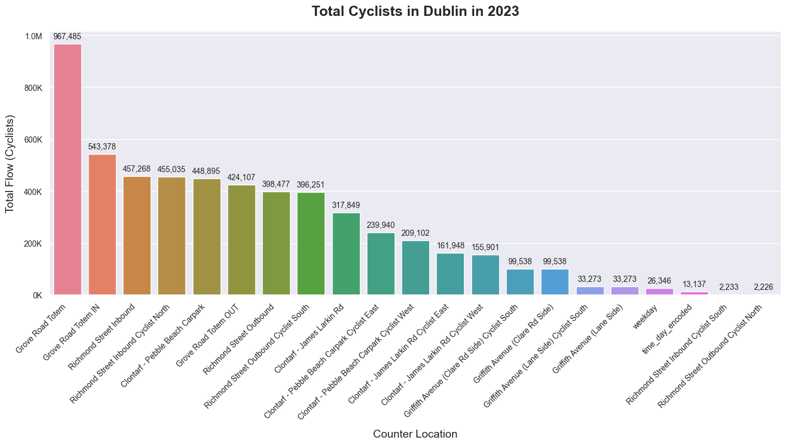
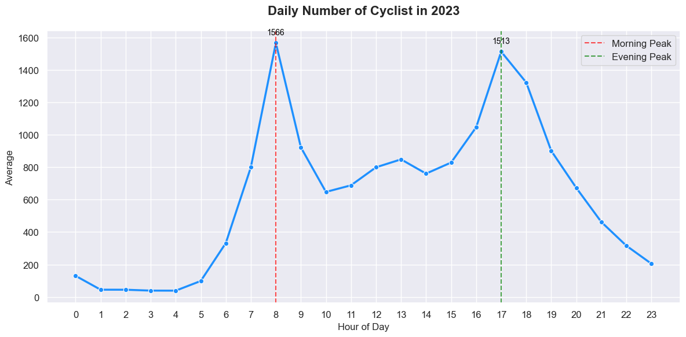


Cycling Traffic - Dublin Council Counters
Infrastructure Promotes Sustainable Mobility
2023246 Joelma Rodrigues | BSc in Computer Science & IT | Data Exploration & Preparation
¹ Department name 24pt Arial and exactly 34pt space between lines
Results
4. Seasonal Number of Cyclists
Identify total number of cyclists in different months.
Introduction
This poster has the objective of applying Exploratory Data Analysis techniques into analysing the cycling patterns in Dublin City supplied by the County Council to identify insights that contribute to planning investment in infrastructure to encourage sustainable mobility.
The dataset consists of collecting the number of cyclists counted and logged every hour, 24h a day, 7 days a week. The counter’s locations are Drumcondra, Charleville Mall, North Strand Rd, Richmond Street and Grove Road.
Key Areas for Cyclists
Figure 5: Seasonal Number of Cyclists
The peak is in May, with nearly 600,000 cyclists. Followed by June, with around 550,000 cyclists. Warm months.
The lowest traffic is in December, with around 300,000 cyclists. Cold month.
Figure 2: Key Areas
Grove Road Totem: High Traffic Density.
Richmond Street: Moderate Traffic Density.
Clontarf: Considerable amount of traffic during specific hours.
Conclusions
Plan Infrastructure: Grove Road Totem, Richmond Street, and Clontarf represent the highest traffic of cyclists. Must be prioritised for investments in infrastructure.
Seasonal Traffic: During cold months, the number of cyclists reduces drastically which is expected. Focus on adjust the demand of public transport to attend these cyclists.
Peak Hours: Peak hours are during the morning when people are dislocated to work or school and, in the evening, when they go home. Ensure traffic lights, signalisation, and main roads are not blocked to prevent holding traffic.
Roadwork: Reallocate cycle counters during roadworks to avoid losing data.
Future Analysis: Analyse cluster to optimize individual traffic interventions in each location.
2. Total Number of Cyclists In 2023 by Location
Identifying the total number of cyclists by location.
Figure 1: Counters Location
Methods
Data Preparation:
Missing values: removed or imputation (by Mean, KNN, and Temporal Interpolation).
Feature Engineering
Exploratory Data Analysis:
Standard Deviation, Mean, Minimum,
Quartiles, and Maximum
Outliers (IQR)
Matrix Correlation
Encoding and PCA:
Label Encoding
Skewness: Box-Co and Yeo-Johnson
Standardisation
Principal Component Analysis
Analysis:
Clustering: K-Means
Total Cyclists – identification of total number of cyclists in 2023 by location
Daily Number of Cyclist – identification of peak hours daily.
Seasonal Number of Cyclists – identification of number of cyclists every month.
Tools:
Jupyter Notebook, Python ( Pandas, Matplotlib, Numpy, Seaborn, Scikit-learn) data manipulation and visualization.
Figure 3: Total Number of Cyclists
Highest Traffic Location: Grove Road Totem with nearly 1 million cyclists.
Lowest Traffic Location: Richmond Street Inbound Cyclist South with only 2,200 cyclists
3. Daily Numbers of Cyclists
Identify average peak hour of cycling traffic in Dublin every day.
References
Dublin City Council and the NTA: Dataset available at https://data.gov.ie/dataset/dublin-city-centre-cycle-counts.
IBM (n.d.): What is Exploratory Data Analysis (EDA)? Available at https://www.ibm.com/topics/exploratory-data-analysis.
Towards Data Science: Guide to Exploratory Data Analysis. Available at https://towardsdatascience.com/a-data-scientists-essential-guide-to-exploratory-data-analysis-25637eee0cf6.
SciPy Documentation: Interpolation Using SciPy. Available at https://docs.scipy.org/doc/scipy/tutorial/interpolate.html.
Atlassian (n.d.): A Complete Guide to Scatter Plots. Available at https://www.atlassian.com/data/charts/what-is-a-scatter-plot.
Leaflet: JavaScript Library for Interactive Maps. Available at https://leafletjs.com/.
OpenStreetMap Contributors (n.d.): OpenStreetMap Data. Available at https://www.openstreetmap.org/.
Eco-Multi Counter from Zelt Diamond Loop: Available at https://traffictechnology.co.uk/blog/portfolio/eco-display-light/.
Marsja, E. (n.d.): How to Use Square Root, Log, & Box-Cox Transformation in Python. Available at https://www.marsja.se/transform-skewed-data-using-square-root-log-box-cox-methods-in-python/.
Iqbal, M. (2024): Data Exploration & Preparation. Delivered as part of the Data Analysis module, BSc (Hons) in Computing in IT, CCT College Dublin. Available at https://moodle.cct.ie/course/view.php?id=1705.
Figure 4: Daily Numbers of Cyclists
8:00 AM - 1560 cyclists.
5:00 PM - 1510 cyclists

